Slide 1
Learn R-Studio from a Working Knowledge of Excel and Up Your Analytics Game
don-E Merson
Scholarship Universe
Masters Student-School of Information

Slide 2
Who am I?
don-E Merson
Scholarship Universe- Programmer/Architect
Masters Student –School of Information
Ph.D. (Accepted but not yet)
Interests
Excel
Data Mining
Statistics
Machine Learning
Economics

Slide 3
Who are you?
Your name
Where on campus?
What do you do?
Experience in Excel
Experience in Programming
Experience in R
Experience in Statistics

Slide 4
Materials
Share Power Point in Box
https://arizona.box.com/s/m0shoa7nyapa8fhqfsdbq8262ueqtqm3

Slide 5

How this class will work
This based on learning techniques from
Notes:
https://www.coursera.org/learn/learning-how-to-learn

Slide 6
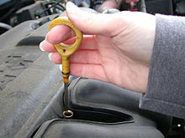
The order of modules
Quiz on things you don’t know
Primes you for important ideas
Opened answered-not graded
I talk about what we are going to learn
You will play along as I talk
You can skip ahead
You take the same quiz again
5 minute break
Quiz is dipstick, not measuring stick
Notes:
https://www.google.com/url?sa=i&rct=j&q=&esrc=s&source=images&cd=&cad=rja&uact=8&ved=0ahUKEwir3ZKI4YLXAhUjsVQKHeBmACYQjRwIBw&url=https%3A%2F%2Fen.wikipedia.org%2Fwiki%2FDipstick&psig=AOvVaw2m2Vt19R6eJtK6opcPn7_e&ust=1508711121590407

Slide 7
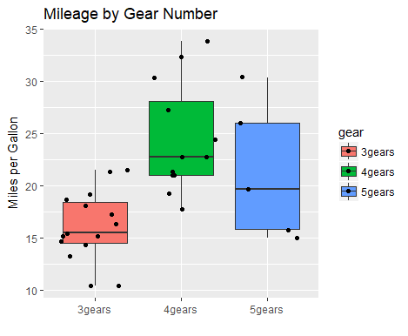
Our modules
You will do this
We might skip around due to class interest
Basic Tour of R-Studio
Excel and Programming Basics
R Statistics
Data Basics
Basic R Graphics
Grammar of Graphics
R File Formats and Publishing

Slide 8
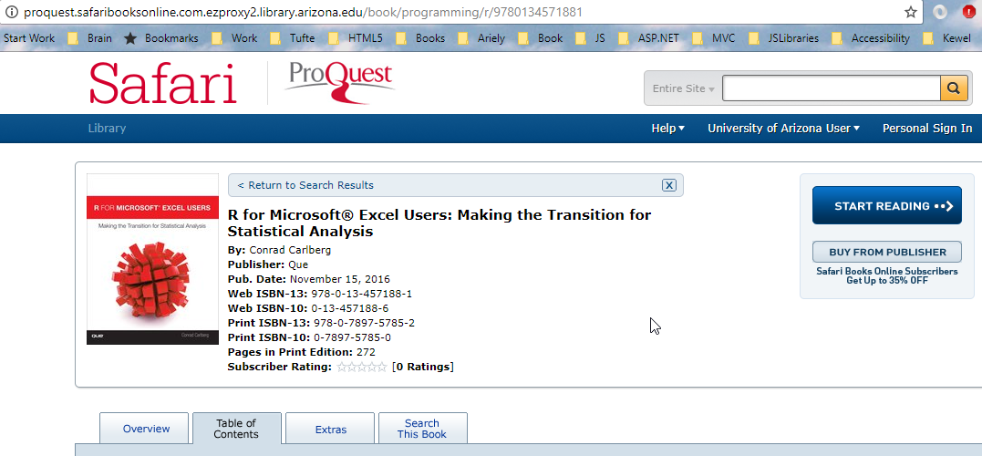
Excel and Stats book-more in depth
Notes:
http://proquest.safaribooksonline.com.ezproxy4.library.arizona.edu/book/programming/r/9780134571881

Slide 9
Module Basic- Tour of RStudio
Goals
Be able to know how to use the following:
Project
Console
Vectors
Variables
Source
Files
Packages
Help
Viewer
History
Intellisense
Cheat Sheets

Slide 10
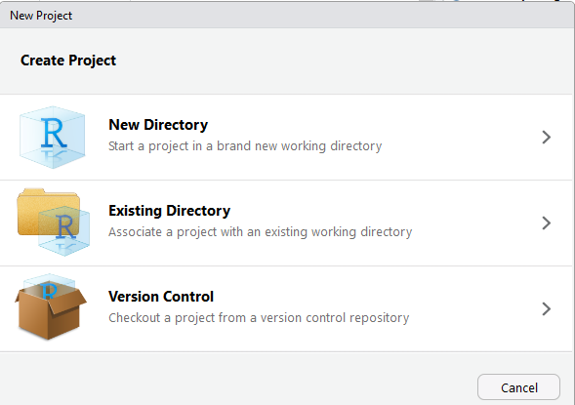
Project (Play along)
File→ New Project…

Slide 11
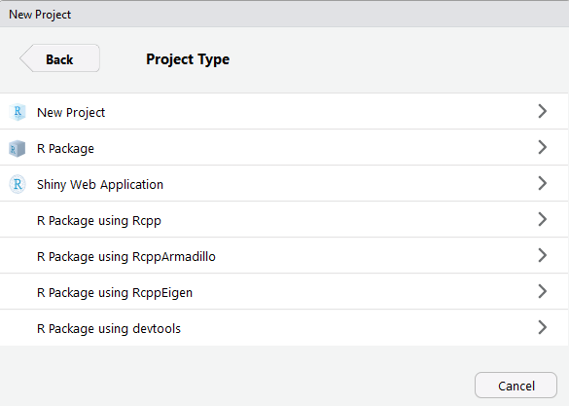
Types of New Projects

Slide 12
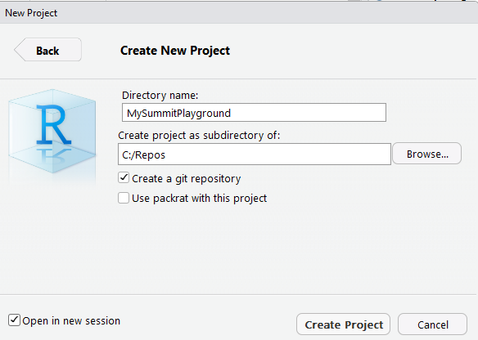
Give it a name

Slide 13
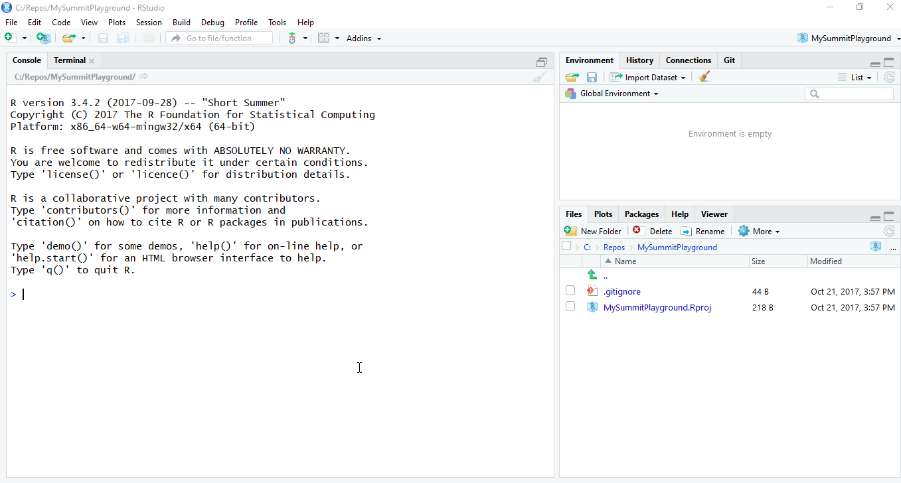

Slide 14
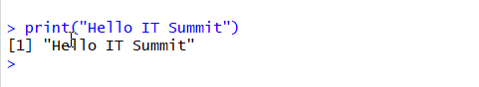
Console
Console is like DOS or Terminal or Shell
Try the following:
What happens if you don’t use quotes?
What happens if type “prin” and tab?
Notice the [1]-we will talk about it later

Slide 15
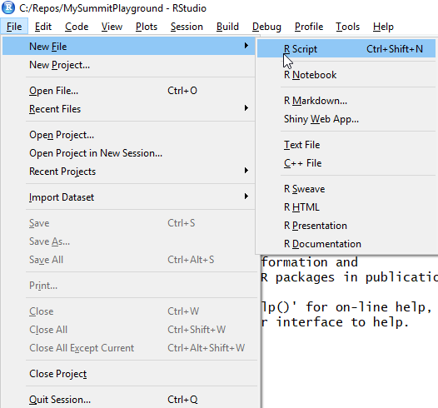
Let’s create a new file

Slide 16
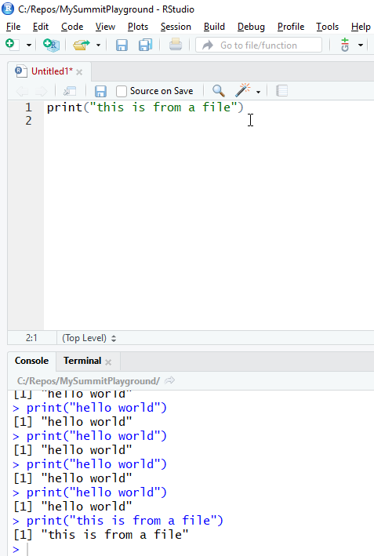
Run a command in source view
Type
print(“this is from a file”)
<control-enter>

Slide 17
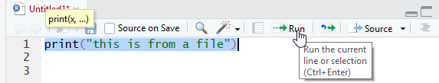
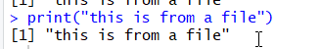
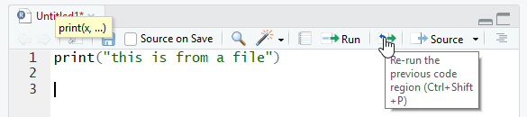
You can also run select and “Run”

Slide 18
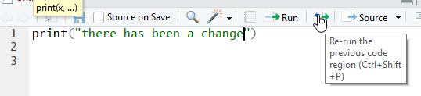
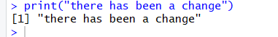
You can change and re-run

Slide 19
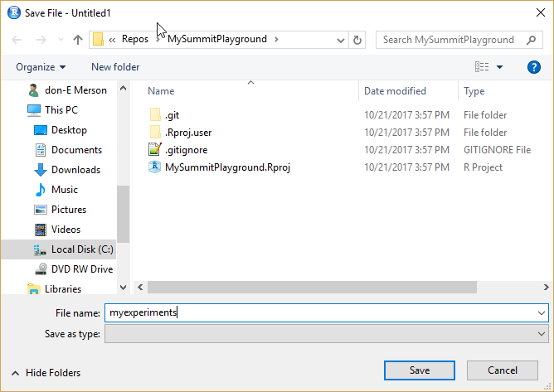
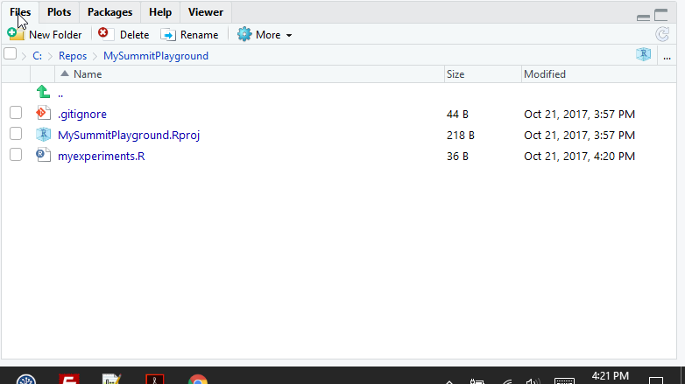
Files
Save the file

Slide 20
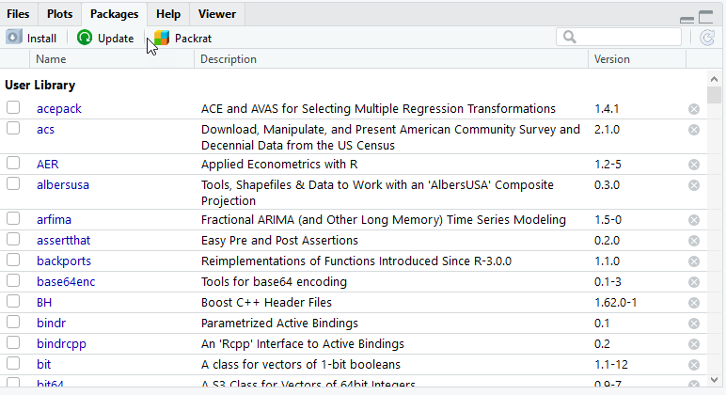
Packages

Slide 21
What is a package?
“Packages are collections of R functions, data, and compiled code in a well-defined format. The directory where packages are stored is called the library. ”-Quick R Web Page
Excel -> R Function =same idea
Data -> values in a defined format
Compiled code-> just means R can run it
Notes:
https://www.statmethods.net/interface/packages.html

Slide 22
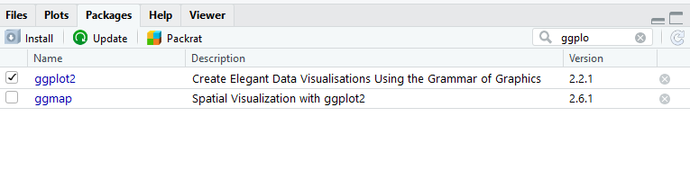
Many ways to load packages
Click on item in Package View if you already have them installed
Use the library() command

Slide 23
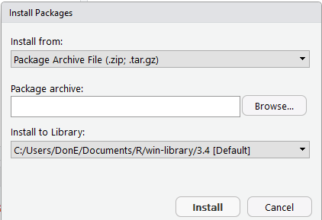
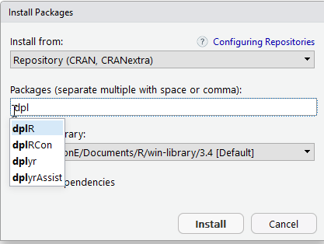
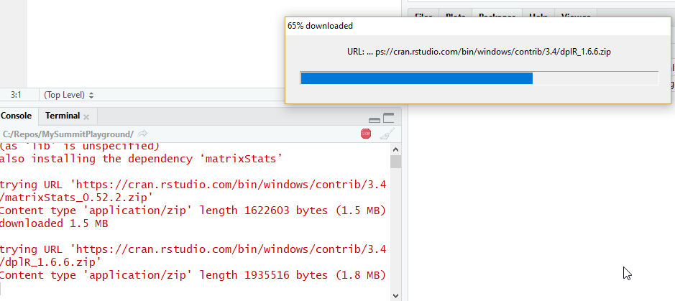
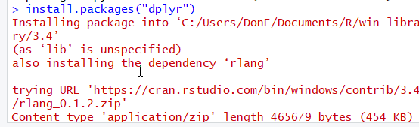
Many ways to install packages

Slide 24

Break

Slide 25
Variables
A variable is a container where you can store some type of value, function, or data
You can set them by variableName =“Value”
Or variableName <- “Value”
The second is more common in R
Try to use second form as sometimes first form doesn’t work

Slide 26
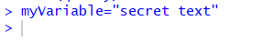
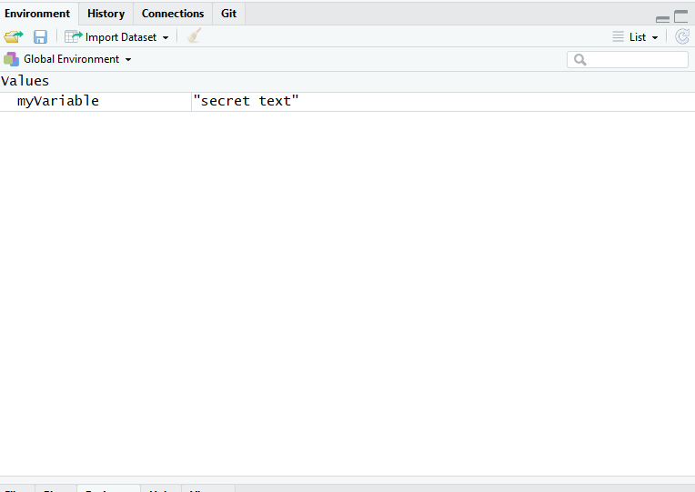
Environment
Type in console

Slide 27
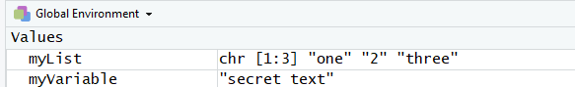
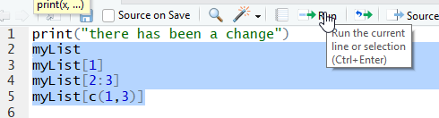
List variables
Type
This creates ->
Type and Run the following

Slide 28
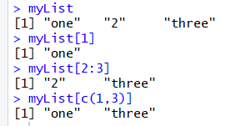
Vector victor
The [1] means it is the first of a vector
For vector think row in Excel
This is a row of 3 items in 1 column

Slide 29
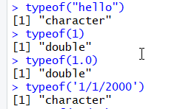
Types
Types defined what operations can be used on data in a variable
Numbers have operations like add, subtract,…
Dataframes have operations like filtering and sorting
Can use typeof command

Slide 30
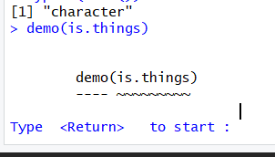
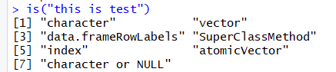
Time to explore

Slide 31
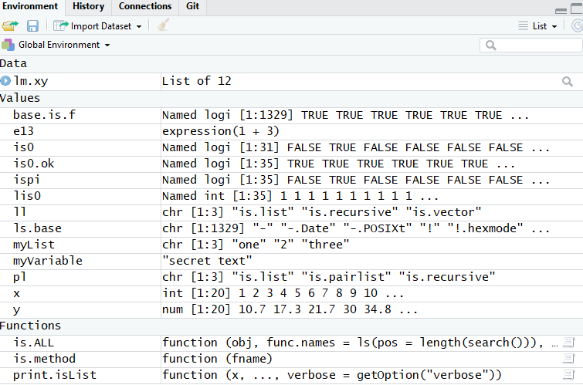
Environment filled up

Slide 32
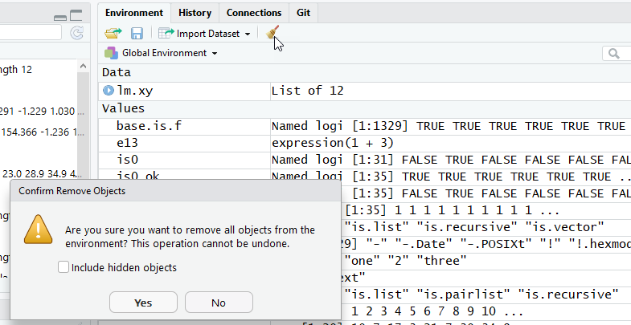
Clear it out

Slide 33
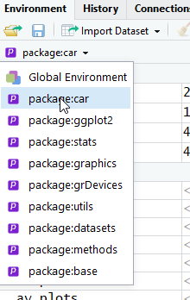
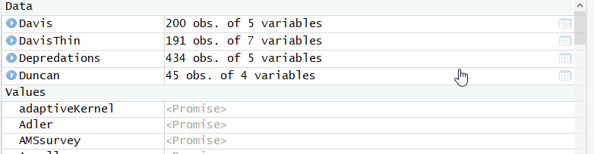
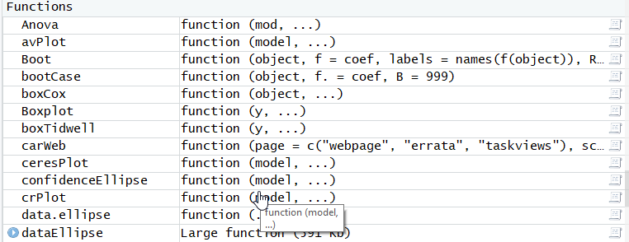
Let’s look at car package

Slide 34
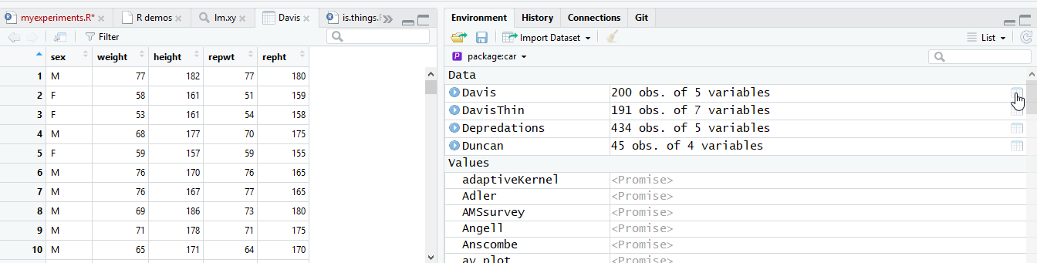
View(Davis)

Slide 35
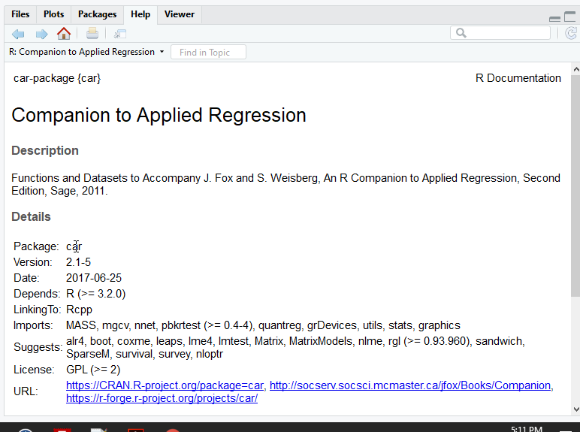
Help
Type

Slide 36
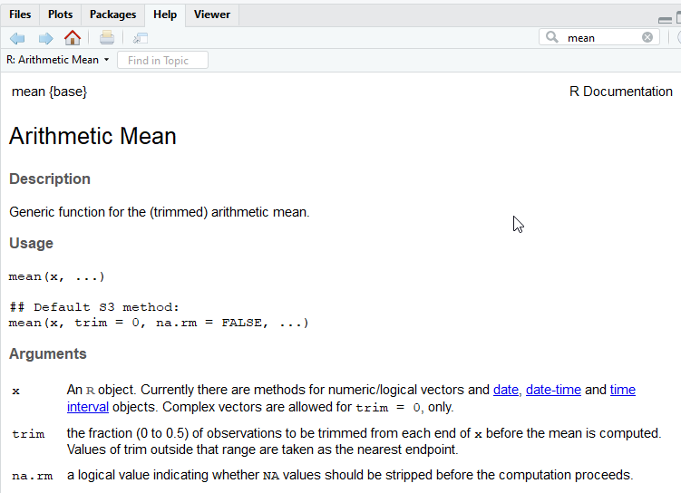
Search Help

Slide 37
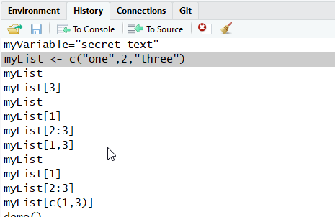
History
You can use up-arrow on keyboard to get previous values

Slide 38
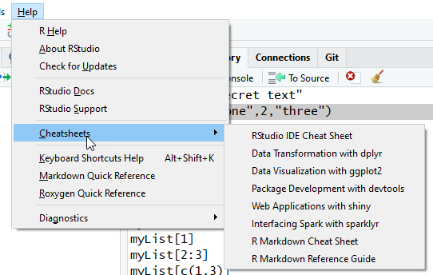
Cheat Sheets

Slide 39
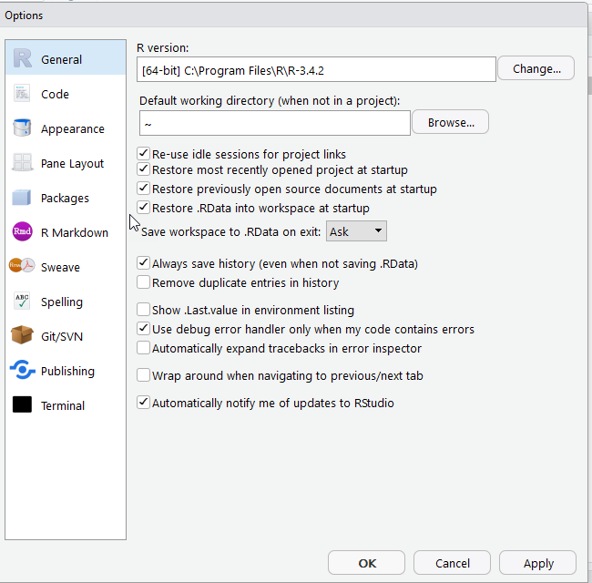
Global Options

Slide 40
Project Options

Slide 41
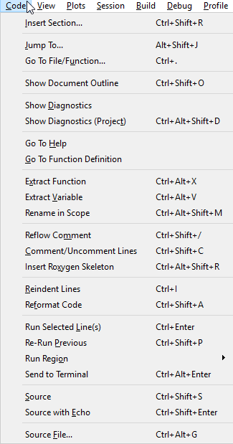
Code Menu
Comment in R is #

Slide 42
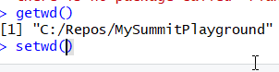
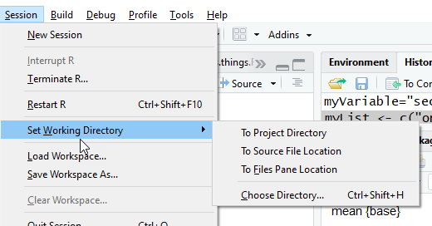
Session and Working Directory
getwd()

Slide 43
Break

Slide 44
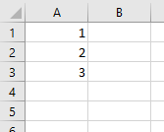
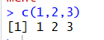
Understanding R from Excel
Vector in Excel
3 rows in 1 column

Slide 45
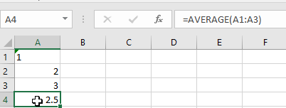
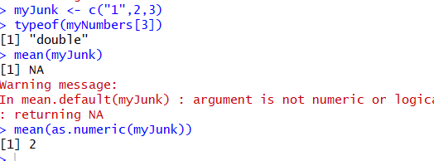
Type in Excel vs. R
Ignores text
In R converts to first value

Slide 46
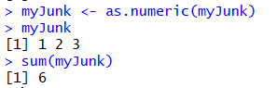

Vectors in R
Allow quick transformations

Slide 47


Can run operations on each item
Vector operations like multiply
Different from aggregates like sum
Summarize into single value (vector of 1)

Slide 48

na =NULL

Slide 49


Matrix
Excel is Column-Row (B2)
R is row-column[3,2]

Slide 50

Mo’ Matrix
Can get rows or columns
Result is vector

Slide 51

Tables in Excel =DataFrame in R

Slide 52

DataFrame$ColumnName

Slide 53


Import data from Excel

Slide 54

We now have a tibbles
(not a whole lot different but better for technical reasons of conversion)

Slide 55

Factors =categorical variables

Slide 56

Data Provenance
Excel is destructive
Make changes =changes data
R can keep original data
If make mistakes can rerun the script

Slide 57

Other Data Imports- Read(base)

Slide 58


Write and read data csv

Slide 59



Ways to view data

Slide 60


Subseting and filtering

Slide 61


More ways to view data

Slide 62


Filter in View mode

Slide 63


Functions vs Sub
Functions return a value
In R have return statement in parens
Can be on multiple lines

Slide 64

Make your own functions
Pro advice
Do 1 thing
Verify it works (Check it in)
Do the next thing

Slide 65



Make it better

Slide 66
Break

Slide 67



Excel has Analysis add-on

Slide 68



Let’s start with common datasets::

Slide 69

cars
summary
str

Slide 70


Using an aggregate function

Slide 71

Common stat functions
Mode is not present
But easy to create

Slide 72




Max and Min and Range

Slide 73




Variance, Standard Deviation, and Correlation

Slide 74


Diff function

Slide 75

Sampling

Slide 76


T-test

Slide 77



Rank-Column, Apply and Lapply

Slide 78

table

Slide 79



Linear Regression

Slide 80


Multivariate Linear Regression

Slide 81


Other multiple regressions

Slide 82


Dummy Variables

Slide 83



Prediction

Slide 84
Stats Cheat Sheet
https://cran.r-project.org/doc/contrib/Short-refcard.pdf

Slide 85
Break

Slide 86
R has lots of graphical packages
lattice
ggplot
Cheat Sheet for ggplot
It is complicated -> Another module
We’ll start with lattice

Slide 87



Demo

Slide 88



Demo (plotlib)

Slide 89


histogram

Slide 90


More hist instructions

Slide 91



Export graphics

Slide 92

plot

Slide 93




Slide 94








Slide 95


Stem and leaf

Slide 96

abline example
Notes:
http://www.sthda.com/english/wiki/abline-r-function-an-easy-way-to-add-straight-lines-to-a-plot-using-r-software

Slide 97



boxplot

Slide 98


density

Slide 99



Slide 100



Slide 101



Slide 102


scatterplot
Notes:
https://www.statmethods.net/graphs/scatterplot.html

Slide 103
Break

Slide 104
dplyr
Package to manipulate data similar in consistent way
Table is tibble
After transformation is still tibble
Other packages
Matrix ->operation >Vector

Slide 105


Consistency allows tricks
These are the same
Assumes results is first parameter to next function

Slide 106


flights

Slide 107
What items are incorrect type?
What is a type?
How about year, month, and day?
What are pros and cons?
How about carrier, origin, and dest?
What are pros and cons?

Slide 108


Converting type for data

Slide 109

dplyr operations on one table
https://cran.r-project.org/web/packages/dplyr/vignettes/dplyr.html
Notes:
https://cran.r-project.org/web/packages/dplyr/vignettes/dplyr.html

Slide 110

Group operations
Notes:
https://cran.r-project.org/web/packages/dplyr/vignettes/dplyr.html

Slide 111


Combing columns

Slide 112

Getting data to join
https://data.world/ian/united-states-university-rankings/workspace/file?filename=TICAS+Percentage+of+2015+Graduates+with+Debt+and+Average+Debt+of+those+with+Loans%2C+by+State.xlsx
Notes:
https://data.world/ian/united-states-university-rankings/workspace/file?filename=TICAS+Percentage+of+2015+Graduates+with+Debt+and+Average+Debt+of+those+with+Loans%2C+by+State.xlsx

Slide 113

Joining tables
inner_join
left_join
right_join
full_join

Slide 114


Think about it first
How many records on inner join vs. full join

Slide 115

Inner join
50 records

Slide 116

Left join
50 records

Slide 117

Right join
51 Records

Slide 118

Full Join
51 records

Slide 119
Seamless inner join
If name is the same will auto connect

Slide 120


sqldf
Can translate to sql
Allows for multiple table join

Slide 121
SQL Keyword
Select
Column names (case sensitive)
From
Tablename
Join to another Tablenamem
On
Value on left and on right
Use table.columnname
Where
Columnname =value

Slide 122
Break

Slide 123
What is Grammar of Graphics?
Different components to graphics
Data and aesthetic mappings
Geometric objects
Scales
Facet specifications
Statistical transformations
Coordinate system

Slide 124

Graphics are built upon layers
Data and mapping
Statistical transformation
Notes:
http://byrneslab.net/classes/biol607/readings/wickham_layered-grammar.pdf

Slide 125

Example Time
ggplot ->create new graphic object
+ layer( …) -> add a layer
The data is diamonds dataset
Map carat to horizontal
Map price to vertical
geom -> display as points in the given position
These are continuous points
Use a Cartesian coordinate system

Slide 126

Another way to write it

Slide 127

The result

Slide 128


Geometric objects

Slide 129


qplot

Slide 130


qplot facets

Slide 131

What are examples of facets?
Need to be categorical variables
How large should they be?
Examples in University data

Slide 132


qplot -ERROR

Slide 133

Box and jitter

Slide 134



Slide 135

Cheat Sheet

Slide 136
Break

Slide 137

R has many different formats
We have been using R Script (Source)

Slide 138
R Notebook
Combines Text and Code and results
Use Markup language
Easier version of HTML
Cheat Sheet!

Slide 139


Slide 140

Run chunk 1

Slide 141

Many ways to Run

Slide 142

Can preview document
Many different formats

Slide 143

Preview

Slide 144




Publish
Aft

Slide 145

Publish Details
You will probably need to setup account

Slide 146

Published!

Slide 147


You can republish updates.

Slide 148

R Markdown

Slide 149

Can output multiple formats

Slide 150

Can make presentations

Slide 151

Knitr makes the presentation

Slide 152

Shiny are interactive html apps

Slide 153

Interactive HTML and R

Slide 154


Install tufte
Can make handbooks based on style of Edward Tufte

Slide 155



Create a Tufte Handout

Slide 156

Tufte Book/Handout

Slide 157

Tufte HTML

Slide 158


R Documentation

Slide 159
Break

Slide 160
Break

